Slide 1

Final Presentation
Project Conceptualization and Development
Project Title: Co-located Collaboration using Augmented Reality
Group: Hugo Ferreira
Practical assignment goal: Development of an AR application that is capable of co-located collaboration.
RVA

Slide 2
Assignment 1
Project Conceptualization
Final Presentation - RVA 2022-2023
2

Slide 3
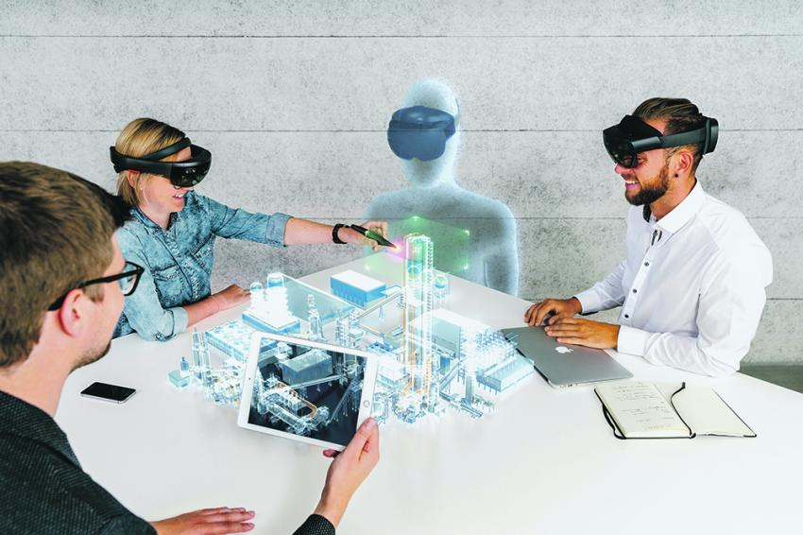
Introduction
Co-located Collaboration using Augmented Reality
My dissertation:
Collaborative Tasks
AR
Midterm Presentation - RVA 2022-2023
3

Slide 4

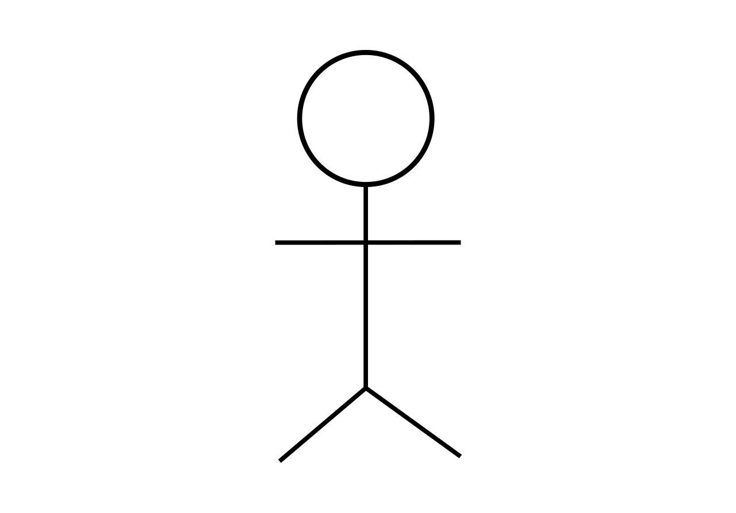

Project Vision
Co-located Collaboration using Augmented Reality
Objective Structure
Augmented Reality
Augmented Reality
Local
Shared Models
Local
Midterm Presentation - RVA 2022-2023
4

Slide 5
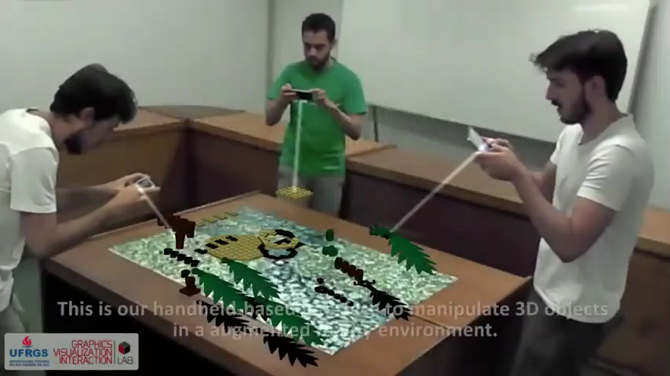
Project Objectives
Co-located Collaboration using Augmented Reality
AR Collaborative experience;
Excerto de https://www.youtube.com/watch?v=vJPk_-l-Cvw&ab_channel=Jer%C3%B4nimoGrandi
Midterm Presentation - RVA 2022-2023
5

Slide 6
Project Constrains
Co-located Collaboration using Augmented Reality
How should the network communication work (position, rotation, ownership);
Give ownership of a piece to a user;
Do not allow users to move pieces outside of the play zone;
Midterm Presentation - RVA 2022-2023
6

Slide 7
Assignment 2
Project Development
Final Presentation - RVA 2022-2023
7

Slide 8
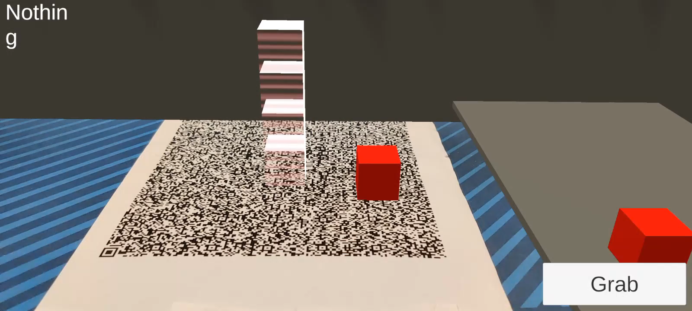
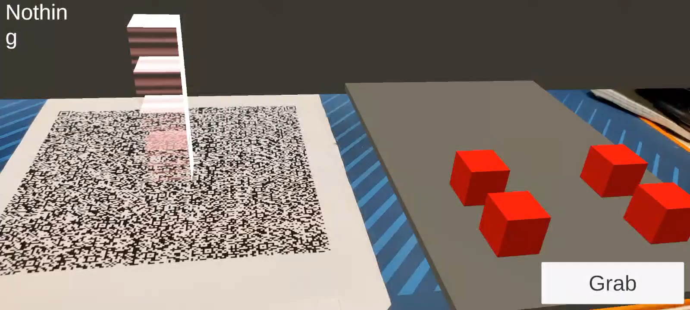
Prototype Developed
Co-located Collaboration using Augmented Reality
Piece Manipulation:
Touch Controls
Movement Based Controls
Final Presentation - RVA 2022-2023
8

Slide 9
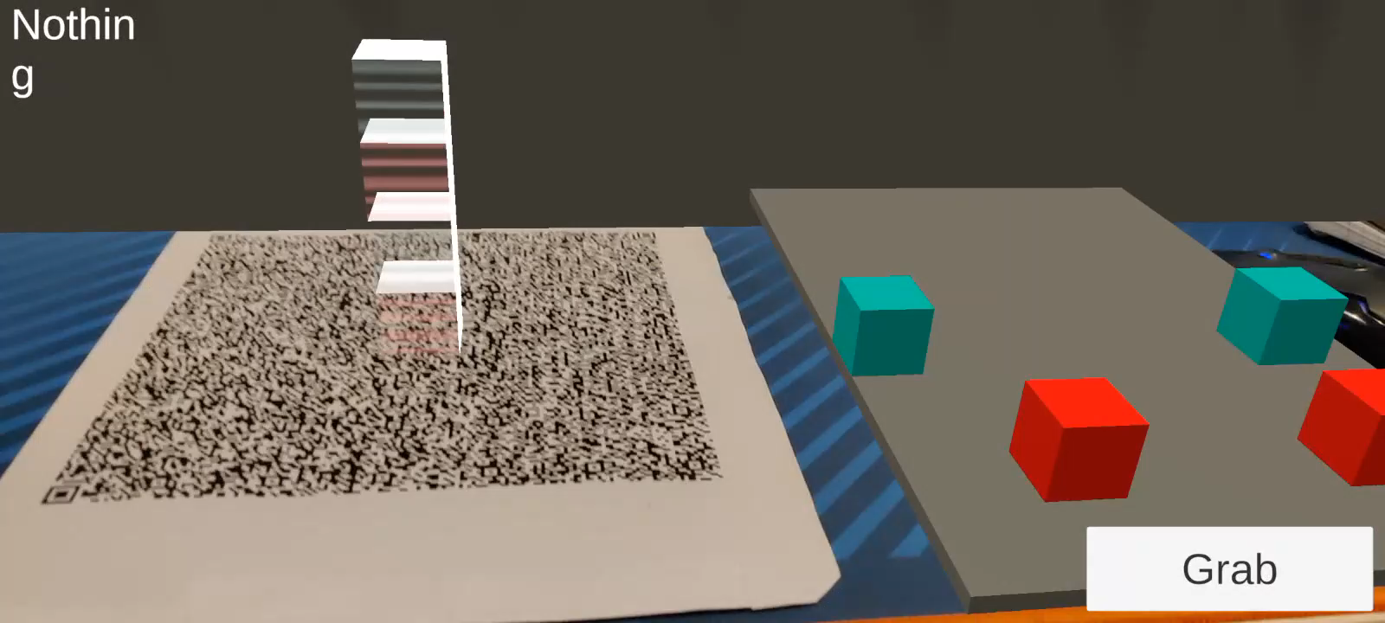
Prototype Developed
Co-located Collaboration using Augmented Reality
Ownership:
Only one person can move a piece at given time;
Every client has to request to own a piece while it moves giving back ownership to the server after;
Differs on which GameMode the level is in:
Everyone: Everyone can move any piece;
Color: A player can only move the pieces of a certain color;
Final Presentation - RVA 2022-2023
9

Slide 10
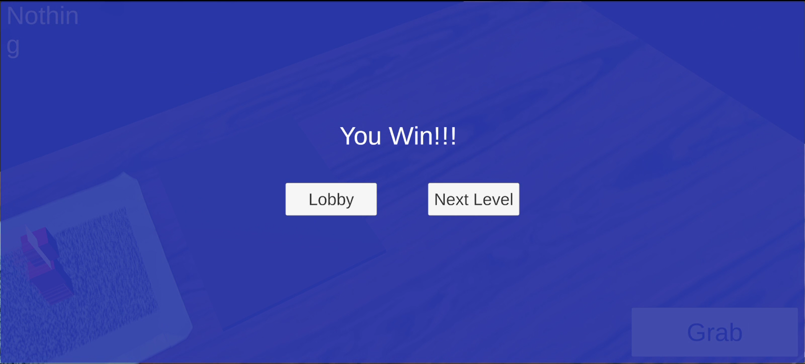
Prototype Developed
Co-located Collaboration using Augmented Reality
Be able to win;
Be able to interact with other users;
Final Presentation - RVA 2022-2023
10

Slide 11
Architecture
Co-located Collaboration using Augmented Reality
AbstractNetworkObject
Responsible for all network objects to spawn themselves
AbstractOwnershipAction
Responsible for all the operations to change the ownership of an object
(ServerRpcs)
LobbyManager
Responsible for all scene transitions (what is the next level)
GameMode
Responsible for all game related logic like deciding who wins
GameManager
Informs players of changes such as when the game ends
Final Presentation - RVA 2022-2023
11

Slide 12

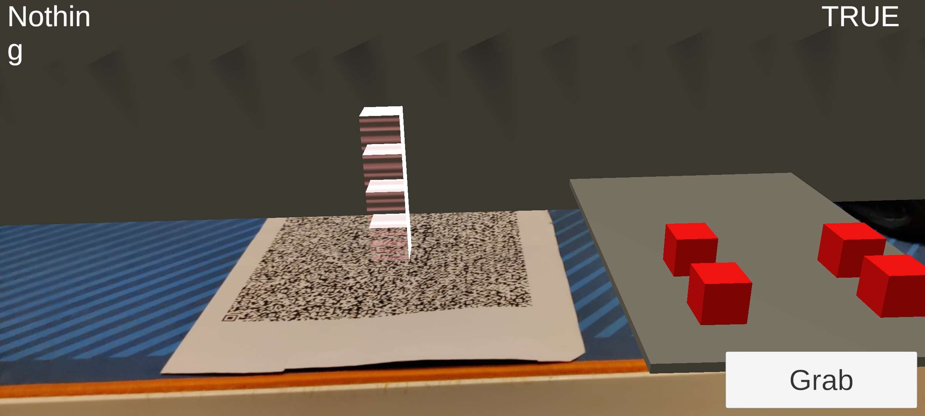
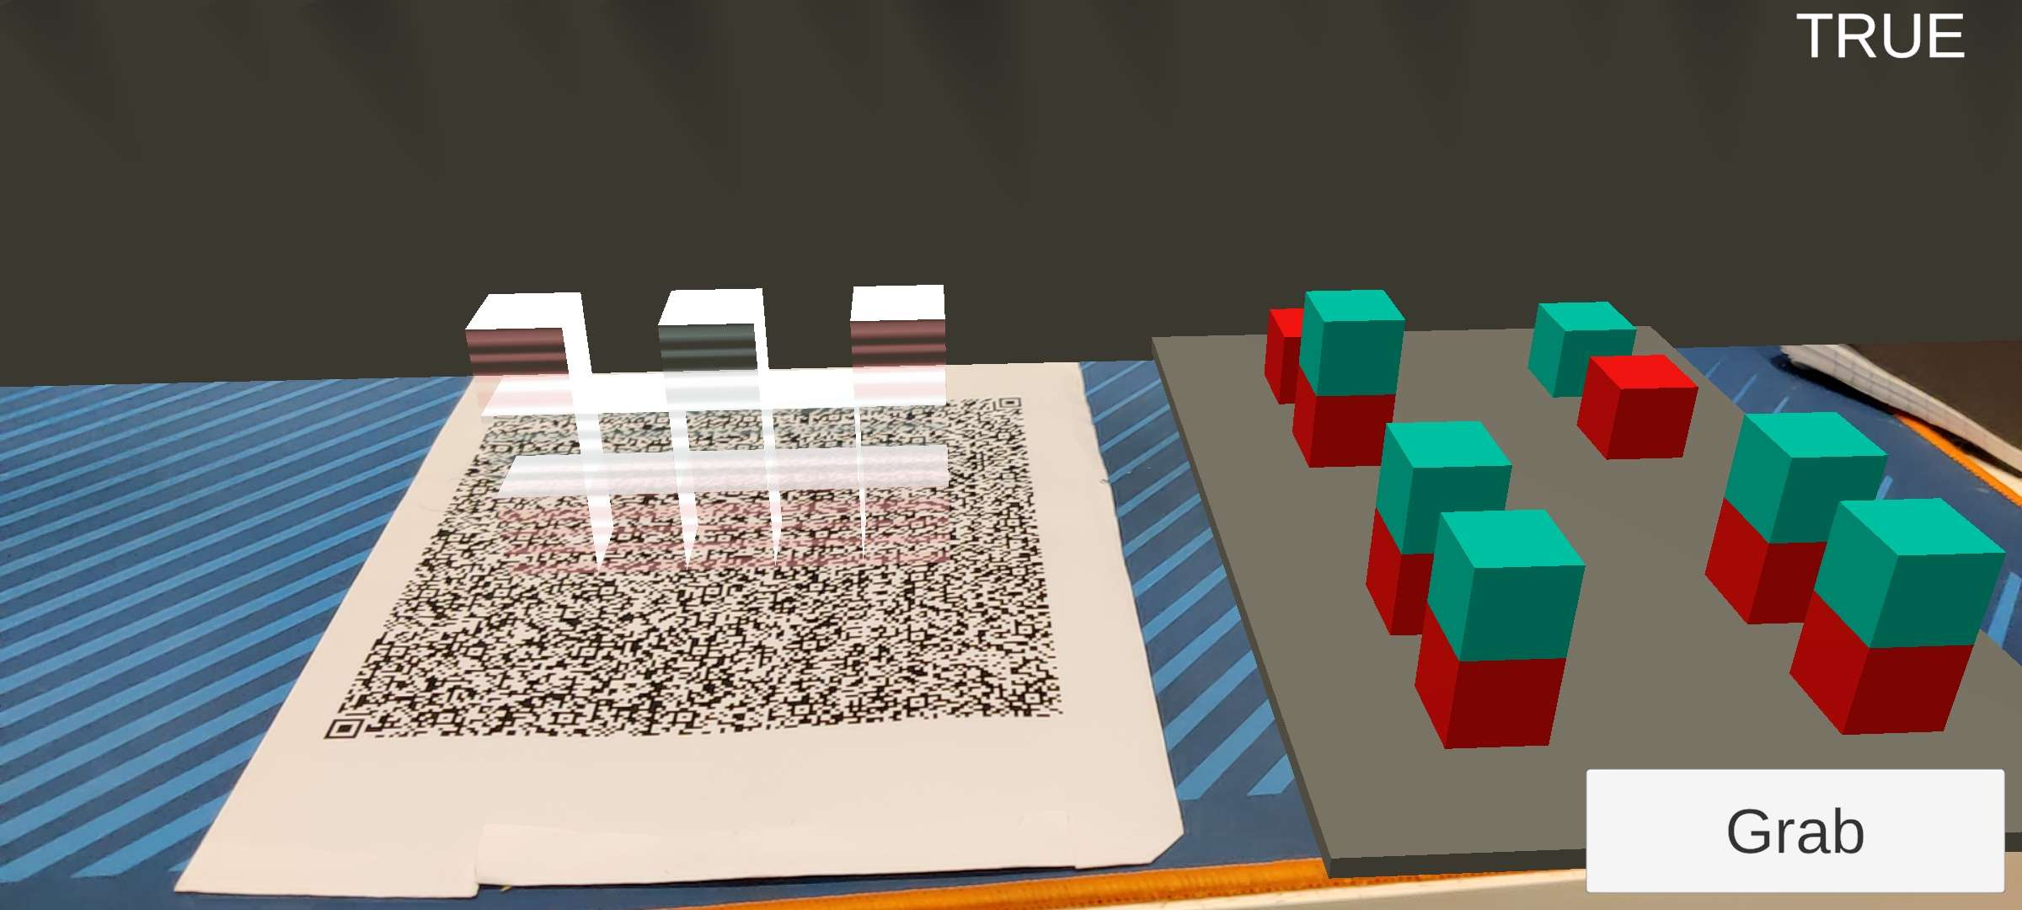
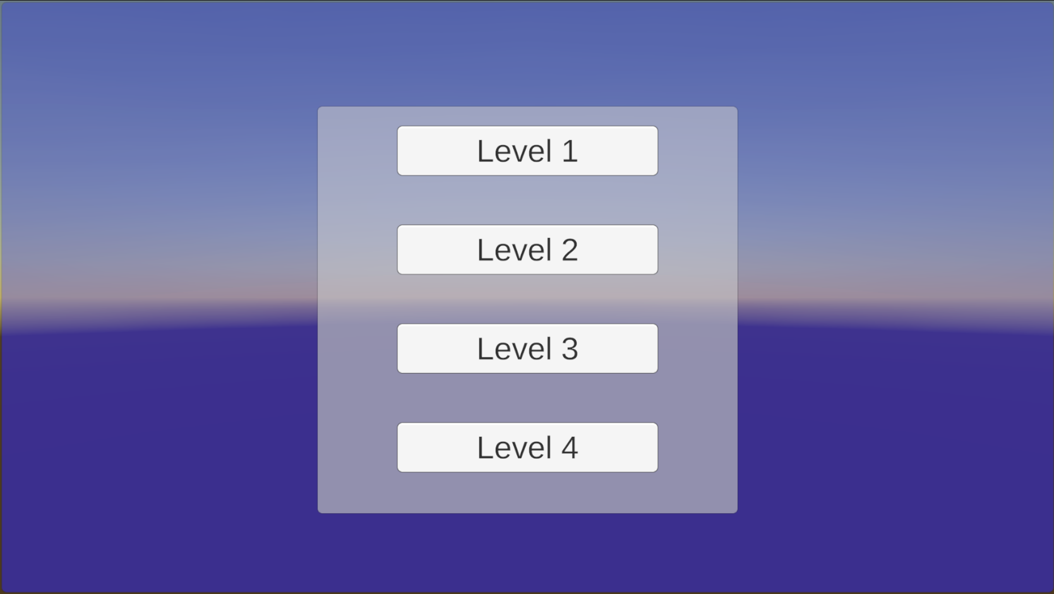
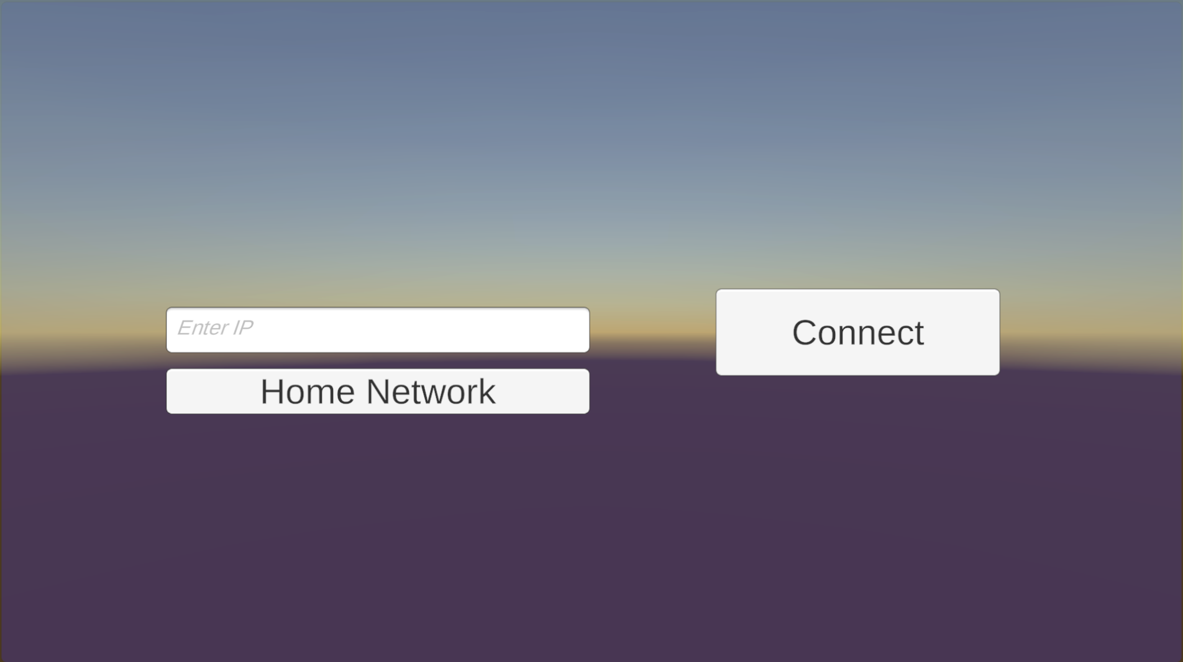
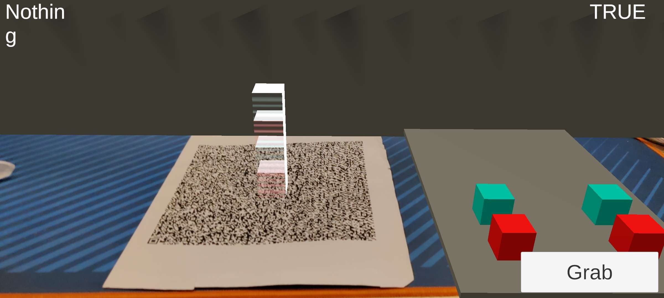
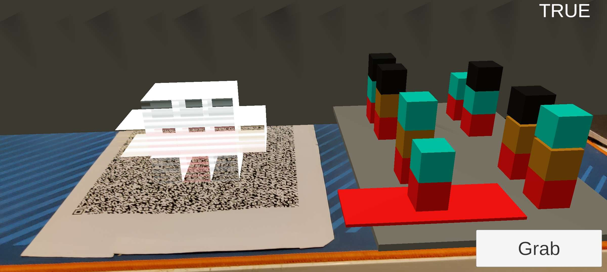
Project Structure
Co-located Collaboration using Augmented Reality
Server
Level 1
Level 3
Lobby
Client/Player
Level 2
Level 4
Final Presentation - RVA 2022-2023
12

Slide 13
Tools Used
Co-located Collaboration using Augmented Reality
Game Engine:
Unity;
Libraries used:
Vuforia – AR integration;
Lean Touch – Touch controls;
Netcode for Game Objects – Networking;
Hardware used:
Android Phone;
Webcam;
Final Presentation - RVA 2022-2023
13

Slide 14
Demo Video
Co-located Collaboration using Augmented Reality
Demos in the Demos folder
Final Presentation - RVA 2022-2023
14

Slide 15
Expectation vs Reality - Project Objectives
Co-located Collaboration using Augmented Reality
Solid AR Collaborative Experience;
Needed more gamification elements;
Very modular design which facilitated the implementation;
Final Presentation - RVA 2022-2023
15

Slide 16
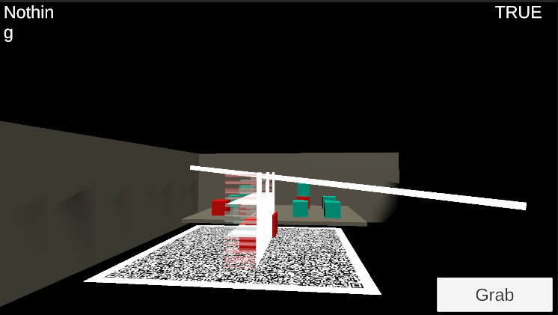
Main difficulties
Co-located Collaboration using Augmented Reality
Networking was only difficult when scene switching was needed;
Experiments with showing a line to where the player is looking;
Errors on the android client were difficult to solve because the error wasn’t shown in the server;
Final Presentation - RVA 2022-2023
16

Slide 17
Future work
Co-located Collaboration using Augmented Reality
Develop more minigames;
Improve the UI/UX (adding tutorials);
Use different models for the pieces (Lego pieces, tangram pieces…);
Better error and disconnect handling;
Final Presentation - RVA 2022-2023
17

